Slide 1
Simplifying SQL Server Migrations
using PowerShell
Chrissy LeMaire
PowerShell MVP
Notes:
In this session, I'll discuss the benefits of using PowerShell to perform SQL Server Migrations. I'll also examine how PowerShell can be used to codify and implement SQL Server best practices.

Slide 2
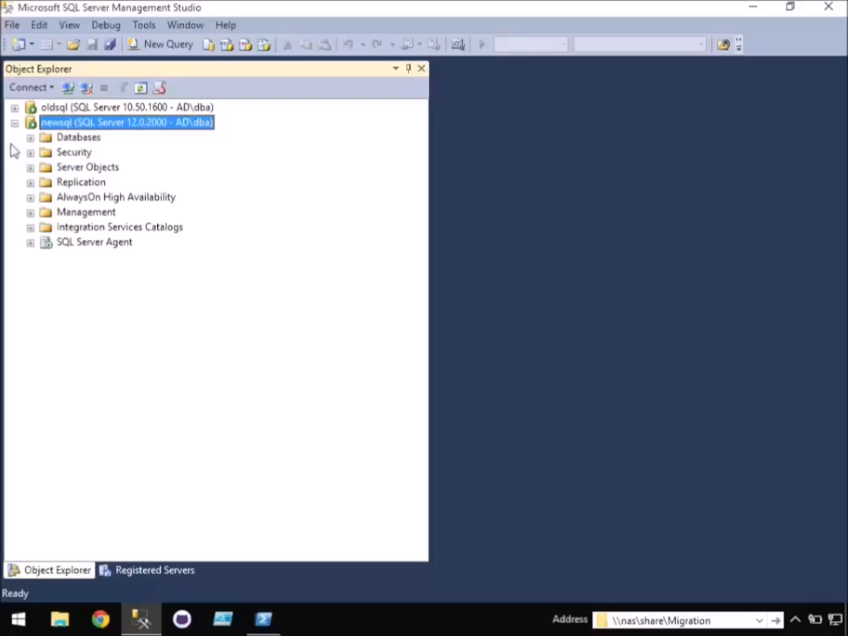
-WhatIf SQL Server migrations went more like this…

Slide 3
Agenda
Who
What
How
PowerShell
1
2
3
4
5
6
Why
Considerations
Demos!
chrissy lemaire, mvp: netnerds.net, @cl code: dbatools.io
Notes:
Won’t go into code much. Using PowerShell to simplify your migrations only requires you to know how to execute a cmdlet.

Slide 4




whoami
Chrissy LeMaire, Microsoft PowerShell MVP
Sr. Systems Engineer/DBA for General Dynamics IT at NATO Special Ops HQ in Belgium
SQL Server since 1999 and PowerShell since 2005
Email: clemaire@gmail.com
Profile:
Chrissy LeMaire
@cl
Tech:
netnerds.net
Food:
RealCajunRecipes.com
chrissy lemaire, mvp: netnerds.net, @cl code: dbatools.io

Slide 5




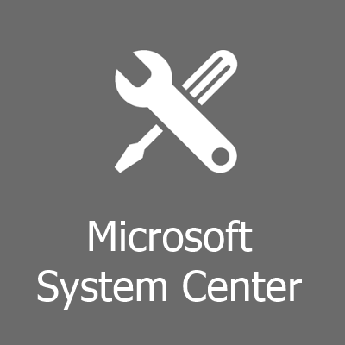
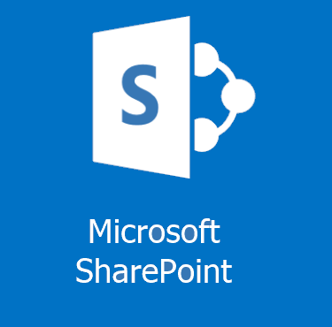
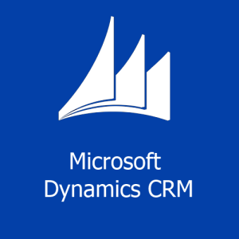
Why Migrate?
Misconfigured SQL Servers
Change in HA Strategy
Consolidation
Resource Requirements /
Best Practices
Platform Changes
SQL Server, OS, hardware, virtualization, Azure
chrissy lemaire, mvp: netnerds.net, @cl code: dbatools.io
Notes:
Misconfigured SQL Servers: In environments without dedicated database administrators, SQL Server is often installed by general technicians who do not optimize the system to deliver peak SQL Server performance. Organizations may also need to move to a different server collation.
Consolidation: uncontrolled server sprawl, cost savings
Change in HA Strategy: Organizations may decide on a new High Availability strategy, such as going from a failover cluster instance to AlwaysOn. Or they may migrate from a clustered instance, to a stand-alone instance, and handle their HA outside of Windows and SQL Server.
Resource Requirements/Best Practices: As an organization’s data requirements grow, SQL Server may outgrow the server on which it was originally built. This has a greater impact on non-virtualized environments, but virtualized servers may also be impacted by resource requirements when one server runs multiple instances of SQL Server, and one instance must be moved to a new server.
SQL Server/OS Upgrade: In-place upgrades are possible for both SQL Server and Windows, but are not ideal for every environment. Physical -> Virtual, or to the cloud, or even dev/test/staging.

Slide 6
What to migrate?
Databases
Logins
Jobs & Schedules
Server Configurations
Linked Servers
Credentials
Reporting Services
Integration Services
Maintenance objects
Availability Groups
Replication Settings
Central Management Server
Operators
Alerts
Proxies
Certificates
Policy Management
Resource Pools
..not an exhaustive list
chrissy lemaire, mvp: netnerds.net, @cl code: dbatools.io
Notes:
There’s a lot to migrate. Pretty much everything you see in SQL Server Management Studio can and perhaps should be migrated.
Server Configs include things like like backup compression defaults, enabling the CLR, etc.
Maintenance objects include things like Ola Hallengren’s backup scripts in the msdb database.

Slide 7
Considerations
there are a few...
Databases
Logins
Complex file structures, filestreams, full-text indexes, edition differences, version compatibility settings, server collation, mirroring, broker-enabled, trustworthy, read-only, owner Availability Groups, replication, associated logins, jobs, linked servers, post migration actions, reattach at source, set source read only, database state, log shipping, currently connected users, is system db, exists at destination,, owner chaining, associated logins, jobs, certificates, packages, etc.
SIDs, passwords, server roles,
server permission sets, credential mapping, password complexity & expiration, default db, owned databases, status, default language,
exists at destination, login type, destination login mode, version/hash compatibility, related objects like jobs, can’t drop if schema owner or assigned a permission set, does windows login exist at destination,
skip built in accounts, certificate mapped, asymmetric keys,
SQL Agent Objects
Linked Servers
related databases, logins, credentials, schedules, disabling on source
OLEDB provider & driver availability, local files, remote login passwords
Server Configs
(sp_configure)
Connstrings
Which applications & logins are connecting from which hosts?
Edition differences (Enterprise -> Std.) Version differences
..not an exhaustive list
chrissy lemaire, mvp: netnerds.net, @cl code: dbatools.io
Notes:
My point is, there’s a lot to think about. And this slide doesn’t even begin to cover it. This underlines why automation is so important. There’s less room for human error because the same checks are run each time, every time.
Databases
Complex file structures, filestreams, full-text indexes, edition differences, version compatibility settings, server collation, mirroring, broker-enabled, trustworthy, read-only, owner Availability Groups, replication, associated logins, jobs, certificates, packages, linked servers, post migration actions, reattach at source, set source read only, database state, log shipping, currently connected users, is system db, exists at destination, owner chaining, etc.
Logins
SIDs, passwords, server roles, server permission sets, credential mapping, password complexity & expiration, default db, owned databases, status, default language, exists at destination, login type, destination login mode, version/hash compatibility, related objects like jobs, can’t drop if schema owner or assigned a permission set, does windows login exist at destination, skip built in accounts, certificate mapped, asymmetric keys, and so on.
SQL Agent Jobs
related databases, logins, credentials, schedules, disabling on source
Linked Servers
OLEDB provider & driver availability, local files, remote login passwords
Server Configs (sp_config)
Edition differences (Enterprise -> Std.) Version differences
Connstrings
Which applications & logins are connecting from which hosts?
Fun lists
http://www.karaszi.com/sqlserver/info_moving_database.asp
http://yrushka.com/index.php/sql-server/database-recovery/sql-server-migration-from-one-server-to-another-detailed-checklist/
http://www.littlekendra.com/2016/01/12/whitepapers-for-planning-sql-server-migrations/
http://passmedia.sqlpass.org/media/24hours/2012_fall/PDF/02.pdf
Webcast
Kendra Little’s migration video
https://www.veeam.com/videos/sql-server-2005-migration-checklist-7008.html

Slide 8
Database migration methods
Backup and restore - well-suited for many situations - solid and straightforward - labor intensive, but scriptable
Detach, copy, attach - solid, but labor intensive - drops some attributes - increased downtime
Import Export Data Wizard - slow - can be messy & error prone - loses attributes and logins
Log Shipping - ideal for large databases - solid, but more complex - edition/version combo issues
Mirroring - ideal for large databases - complex - edition dependent
Copy Database Wizard - decent for small migrations - prone to errors - drops some attributes - dependencies often error out
chrissy lemaire, mvp: netnerds.net, @cl code: dbatools.io
Notes:
Backup / Restore
maintains most of the database attributes, except for db owner
Ideal for going between different editions like Express and Enterprise, and also different SQL Server versions.
When compression is enabled, it can actually be one of the faster ways to migrate a database.
Detach / Attach
Time consuming - it copies over white space unlike backup and restore, and you might have to traverse through deep directory structures when you're copying over data and log files.
Import / Export Wizard * SMO / not same database in the end
Has been described as "torturous" to use. I've actually never even used this in production, so I'll just skip this one.
Log shipping (initially uses backup/restore)
Cutover time is drastically reduced, especially when you compare it to the two previous methods. However, it is a little more complex, and it may not be supported by all SQL Server Edition and Version combinations. Nowadays, most often used temporarily, especially for migrations.
Classic Mirroring and AlwaysOn Advanced Mirroring (initially uses backup/restore)
Edition dependent, so you can't go from Standard to Enterprise. Also, Classic Mirroring was actually deprecated in SQL Server 2012. It is not version dependent though. So you can use this method to migrate between different versions of SQL Server.
Copy Database Wizard Export Import/Export / Detach Attach
The copy database wizard supports detach/attach /and/ SMO which is basically an import/export.
It provides a nice wizard interface, but is still pretty manual, especially when you're migrating multiple databases with complex file structures.
3rd Party Tools & SQL Server Replication
As far as 3rd party tools go, there are some have been recommended for database migration, but I always try to use natively available options, because these tools might not be available at every place I work, and procurement usually takes a while.
You can also check out Robert David’s Migration by Replication resources
http://www.sqlsoldier.com/wp/logshippingtricksdemo
http://sqlmag.com/database-high-availability/3-log-shipping-techniques
Mirroring vs Log Shipping
With Log Shipping:
Data Transfer: T-Logs are backed up and transferred to secondary server Transactional Consistency: All committed and un-committed are transferred Server Limitation: Can be applied to multiple stand-by servers Failover: Manual Failover Duration: Can take more than 30 mins Role Change: Role change is manual Client Re-direction: Manual changes required
With Database Mirroring:
Data Transfer: Individual T-Log records are transferred using TCP endpoints Transactional Consistency: Only committed transactions are transferred Server Limitation: Can be applied to only one mirror server Failover: Automatic Failover Duration: Failover is fast, sometimes < 3 seconds but not more than 10 seconds Role Change: Role change is fully automatic Client Re-direction: Fully automatic as it uses .NET 2.0
Source http://bit.ly/1XEhFJJ

Slide 9
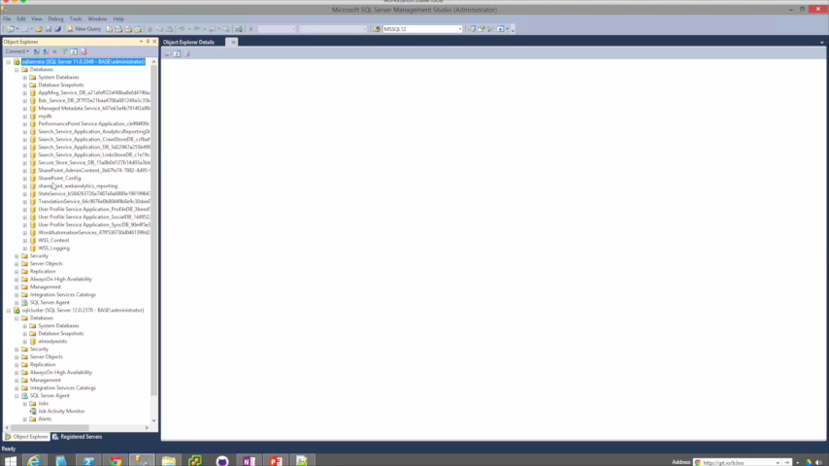
Copy Database Wizard / Detach Attach demo
chrissy lemaire, mvp: netnerds.net, @cl code: dbatools.io
Notes:
Even speeding up the video still takes awhile to migrate just a few small databases. The mistake I made while filming this was genuine, too.

Slide 10
Login migration methods
SSIS Transfer Logins Task
Very painful
changes passwords
disables account
does not transfer server roles or server permission sets
maintains SIDs
sp_help_revlogin Less painful, but still..
maintains passwords & SIDs
doesn’t disable account
does not transfer server roles or server permission sets
still manual / doesn’t scale well
chrissy lemaire, mvp: netnerds.net, @cl code: dbatools.io
Notes:
Microsoft provided the Transfer Logins Task within SSIS, which is based on SMO This method is extremely painful. It changes the passwords, disables the account, and doesn't transfer server roles of server permission sets. But! It does maintain the login SID.
Then there's sp_help_revlogin which you're probably familiar with
I once considered this stored procedure from Microsoft a god-send because it maintains the SIDS, migrates the password, and doesn't disable the account, however it also doesn't transfer server roles or server permission sets, and in my experience, most DBA's actually use this script as a starting point, and then build additional functionality on top of it.
Even then, it's still a manual process that doesn't scale well, especially when you are migrating logins for several servers, or want to migrate the logins on an ongoing basis.

Slide 11
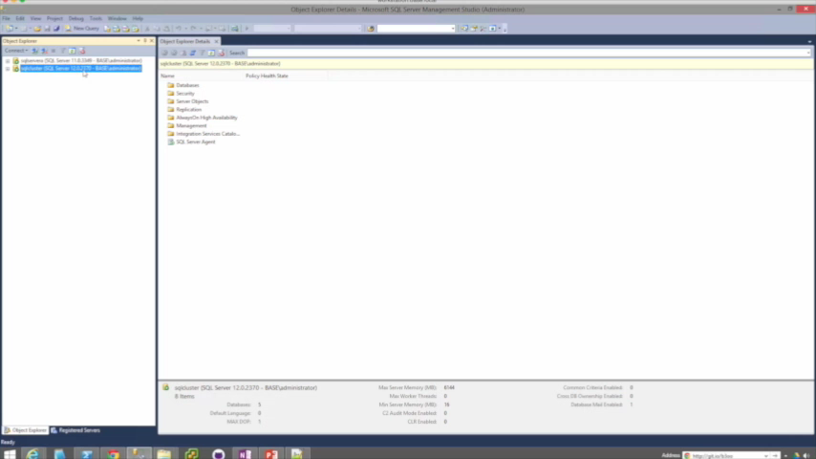
Login migrating using sp_help_revlogin
chrissy lemaire, mvp: netnerds.net, @cl code: dbatools.io
Notes:
This one is not sped up, so that you can be tortured along with me.
It’ll often bomb out. Doesn’t copy roles or server permission sets.

Slide 12
Migrating other stuff
Job Server Objects
AlwaysOn
SSIS Transfer Logins Task
Very painful
changes passwords
disables account
does not transfer server roles or server permission sets
maintains SIDs
sp_help_revlogin Less painful, but still..
maintains passwords
maintains SIDs
does not transfer server roles or server permission sets
still manual / doesn’t scale well
SSMS / SMO / SSIS Transfer Job Task / restore msdb
Highly scriptable within SSMS & SMO
Server Configs
Database Mail
Use some T-SQL or SMO to craft some
T-SQL to execute some T-SQL
SMO, T-SQL, may include credentials
Linked Servers
Credentials
No way provided by Microsoft that includes passwords
No way provided by Microsoft that includes passwords
Finding SQL Server Keys
Central Management Server
Dig through the registry
Import/Export but sometimes errors on import
chrissy lemaire, mvp: netnerds.net, @cl code: dbatools.io
Notes:
There’s so much more, but here’s a start.
First, for the job sever otherwise known as SQL Server Agent, you can perform a migration in a variety of ways, up to and including restoring the msdb database, although that does introduce a few complexities, so I tend to migrate using scripts.
With AlwaysOn, this is also highly scriptable using SSMS and SMO.
sp_configure. now I've seen a few ways to do this, but mostly you use some T-SQL or SMO, to craft some T-SQL to execute on another SQL Server.
Central Management Server, does have built in import/export functionality, but you may encounter a terminating error on import when the destination CMS server name is contained within the XML import file.
Linked Servers, are challenging to migrate because of the way that the passwords are stored, that is, not within the database engine, but rather, encrypted deep within the registry. Same goes for Credentials.
Now when it comes to Finding your SQL Server key, this isn't too hard, there are scripts available online that will do it for you, but it does require digging through the registry if you're doing it manually. SQL keys ae useful for upgrading/downgrading editions.
And finally, database mail can be migrated using SMO, or T-SQL, but keep in mind that it may contain credentials, which brings us back to the challenge of decrypting these passwords in order to migrate the associated credential.

Slide 13
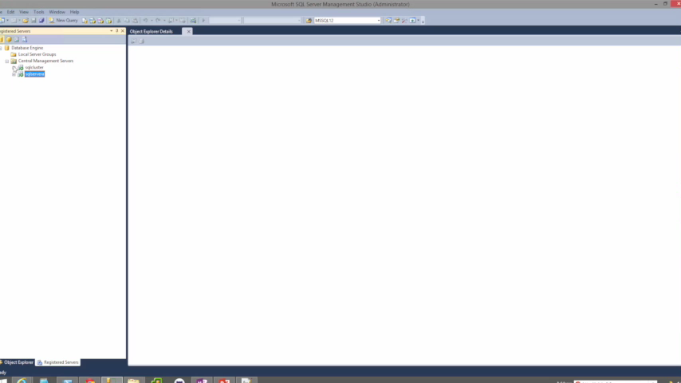
How CMS Import/Export usually goes for me.
chrissy lemaire, mvp: netnerds.net, @cl code: dbatools.io
Notes:
There are very few situations where this doesn’t error out. I usually have to edit the XML to remove the duplicate server.

Slide 14

PowerShell, the better way.
dbatools module
Copy-SqlLogin
Copy-SqlDatabase
Copy-SqlServerAgent
Copy-SqlSpConfigure
Copy-SqlDatabaseMail
Copy-SqlBackupDevice
Copy-SqlServerTrigger
Copy-SqlLinkedServer
Copy-SqlCredential
Copy-SqlSysDBUserObjects
Copy-SqlCentralManagementServer
Copy-SqlAudit
Copy-SqlAuditSpecification
Copy-SqlAgentCategory
Copy-SqlAlert
Copy-SqlCustomError
Copy-SqlDataCollector
Copy-SqlEndpoint
Copy-SqlExtendedEvent
Copy-SqlOperator
Copy-SqlPolicyManagement
Copy-SqlProxyAccount
Copy-SqlResourceGovernor
Copy-SqlServerTrigger
Copy-SqlSharedSchedule
Start-SqlMigration & Test-SqlMigrationConstraint
Remember: Get-Help
chrissy lemaire, mvp: netnerds.net, @cl code: dbatools.io
Notes:
Used to dread but now it’s fun
When I was preparing for my own migration at work, I thought there has to be a better way to do all of this. Initially, I was automating sp_help_revlogin and then I thought I should go to pure PowerShell, and that’s really where this all got started.
In the end, I compiled a number of scripts into a PowerShell module that I call dbatools that has a number of commands DBA’s are going to love.
When building these commands, I always try to support SQL Server 2000-2016, clusters, named instances, and all editions from Express to Enterprise. Most do require sysadmin access and will error out. If you have any questions, I do try my best to properly document each command.
Copy-SqlLogin
This command supports all editions of SQL Server 2000-2016, and it migrates both SQL Logins and Windows logins.
It can add, overwrite when force is specified, or sync. The sync switch syncs permissions, but does not add accounts.
If you do use force, force will drop and recreate the specified logins, except for the one executing the script, and the SQL Service account login.
By default, all logins are migrated. The include switch will only migrate the specified logins. It's also automatically populated by the logins on the source server for tab completion. Exclude logins will migrate ALL logins except for those specified.
Copy-SqlDatabase
Migrates in two ways: backup/restore and detach/attach
It does not migrate system databases. Migrates including all file groups, filestreams and full-text indexes.
Supports NoRecovery!
Copy-SqlJobServer and Copy-SqlDatabaseMail are very basic, they just copy everything.
Copy-SqlLinkedServer and Copy-SqlCredential are also similar. You can specify which linked servers and credentials you want. Requires remote registry on.
Copy-SqlCentralManagementServer, copies all groups & subgroups.
Export-SqlSpConfigure to path. Import-SqlSpConfigure from file or from server.
Start-SqlMigration combines all of this!!! And transcribes!

Slide 15
How to Get-Help
Extensive documentation within each command Get-Help Start-SqlMigration –Detailed
Extensive documentation on dbatools.io
dbatools.io/Start-SqlMigration
dbatools.io/Repair-SqlOrphanUser
Some commands have videos
dbatools.io/youtube
chrissy lemaire, mvp: netnerds.net, @cl code: dbatools.io

Slide 16
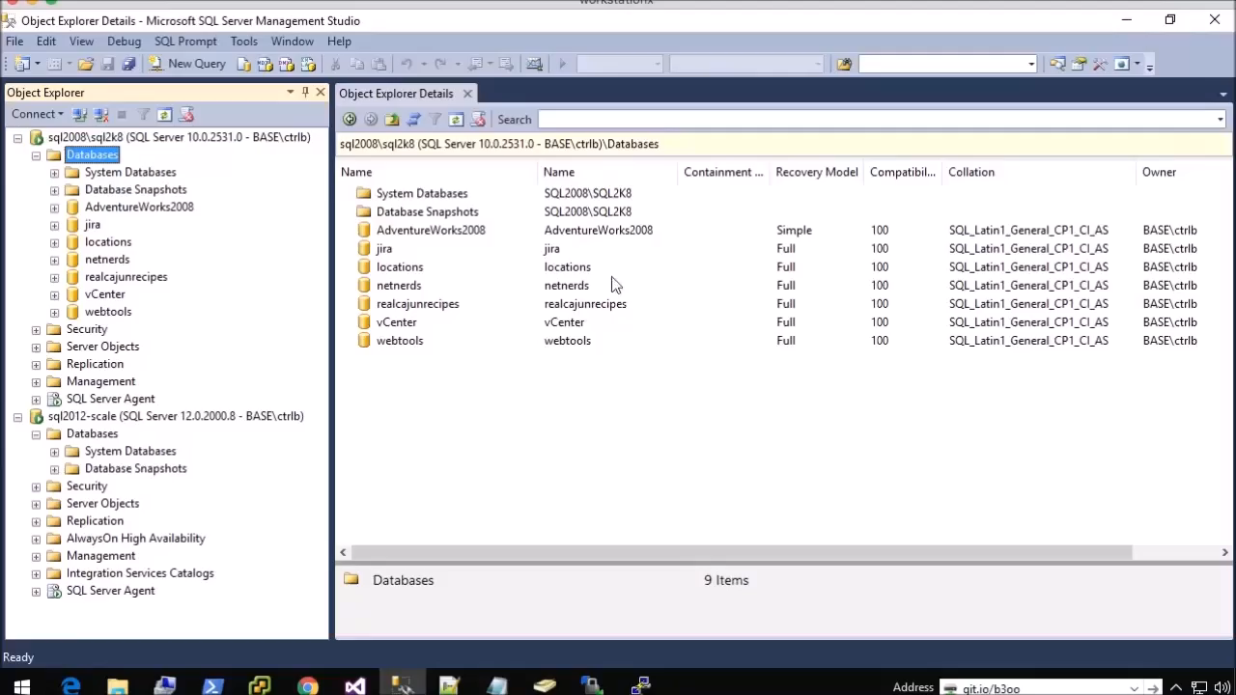
Bonus Video! Fun with Out-Grid
chrissy lemaire, mvp: netnerds.net, @cl code: dbatools.io

Slide 17
Review
PowerShell <3 SQL Server <3 PowerShell
Simplifies, and also prevents human error
No more checklists or boredom
Be a hero and impress your friends
Find it at dbatools.io
Also, dbareports.io is awesome
chrissy lemaire, mvp: netnerds.net, @cl code: dbatools.io
Notes:
Copy-SqlDatabase
SQL Server 2000-2014, clusters, named instances, all editions
DB – Backup/Restore & Detach/Attach
User objects in system databases (such as Hallengren’s scripts)
Complex file structures, FILESTREAM, file groups, full-text indexes
Move one, many or all databases
Command-line auto completion of databases
Automatically determines default data and log directories
Supports reusing exact folder structures
Copy-SqlLogin
SQL Server 2000-2014, clusters, named instances, all editions
Windows & SQL Authentication
SIDs, passwords, permission sets, roles, default db
SyncOnly option syncs permissions
Include or exclude any specific login (auto-completed)
Does not currently support certificate mapped or asymmetric keys
Does not migrate credentials. Use Copy-SQLCredential
Start-SqlMigration
Shortcut command to migrate entire instance, including databases, logins, credentials, linked servers, db mail, etc.
Copy-SqlCredential
Migrates passwords
Requires remote registry access
Copy-SqlLinkedServer
Migrates passwords
Migrates only if provider exists on destination server
Does not migrate ODBC connections (yet) or drivers
Does not copy over local files, such as SQLite databases
Requires remote registry access
Copy-SqlCentralManagementServer
Copies Registered Servers from CMS to CMS
Migrate one, multiple or all server groups
Get-SqlServerKey
SQL Server 2005-2014, clusters, named instances, all editions
Server list: command line, file, or Central Management Server
Finds keys for all instances on a server
Requires remote registry access for remote servers
Watch-SqlDbLogin
Helps find connstrings that need to be updated
Does not require SQL Server Auditing, but can be less accurate
How to move databases between computers that are running SQL Server: http://support.microsoft.com/kb/314546
Minimizing DB Migration Downtime Using Log Shipping: http://blogs.msdn.com/b/sqlgardner/archive/2011/09/16/minimizing-db-migration-downtime-using-log-shipping.aspx
Migrating a VLDB in SQL Server with Log Shipping: http://www.mssqltips.com/sqlservertip/2073/migrating-a-vldb-in-sql-server-with-log-shipping/
SQL Server Database Migration Checklist: http://www.mssqltips.com/sqlservertip/1936/sql-server-database-migration-checklist/
Understanding the value of Enterprise Edition, one feature at a time: http://blogs.msdn.com/b/ialonso/archive/2011/09/21/understanding-the-value-of-the-enterprise-edition-one-feature-at-a-time.aspx
Using Mirroring to Reduce DB Migration Downtime: http://blogs.lessthandot.com/index.php/datamgmt/dbprogramming/move-databases-to-new-server-with-little-1/
Prerequisites, Restrictions, and Recommendations for Database Mirroring: https://msdn.microsoft.com/en-us/library/ms366349.aspx?f=255
What is the relationship between logins, credentials, and proxies? And why they were introduced? http://www.jasonstrate.com/2013/07/security-questions-logins-credentials-and-proxies
How to migrate SQL Server 2008 to a new server: http://www.bidn.com/blogs/MMilligan/bidn-blog/3207/how-to-migrate-an-instance-of-sql-server-2008-to-a-new-server
Ola Hallengren’s SQL Server Maintenance Scripts: https://ola.hallengren.com/
Migrating a SQL Server instance: http://www.mssqltips.com/sqlservertip/1246/migrating-a-sql-server-instance/
Registered Servers and CMS: https://www.simple-talk.com/sql/sql-tools/registered-servers-and--central-management-server-stores/
Never ever set up a Database Mirroring session across different SQL Server Editions (SKU): http://blogs.msdn.com/b/ialonso/archive/2011/11/09/never-ever-set-up-a-database-mirroring-session-across-different-sql-server-editions-sku.aspx

